Slide 1
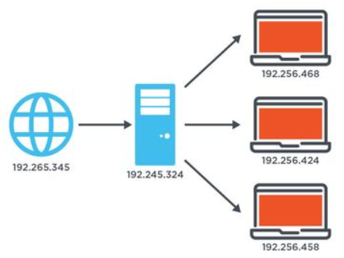
Internet Protocols
Dr. Muhammad Habib

Slide 2
Introduction to Internet Protocols
Email is a common communication method that we all know about.
But before existed the alternative was to send mail to one another through the postal system.
There is a surprising parallel between the postal system and how the computer sends and receives data across the internet every day.
Let's compare how they both work.

Slide 3
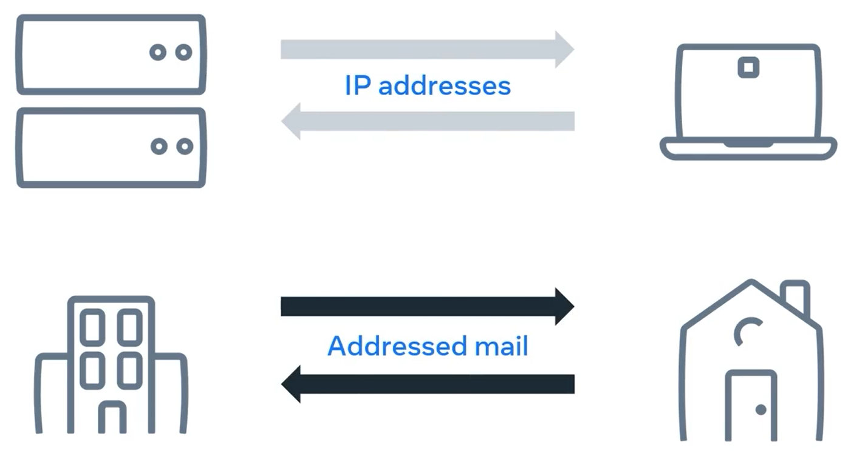
Introduction to Internet Protocols

Slide 4
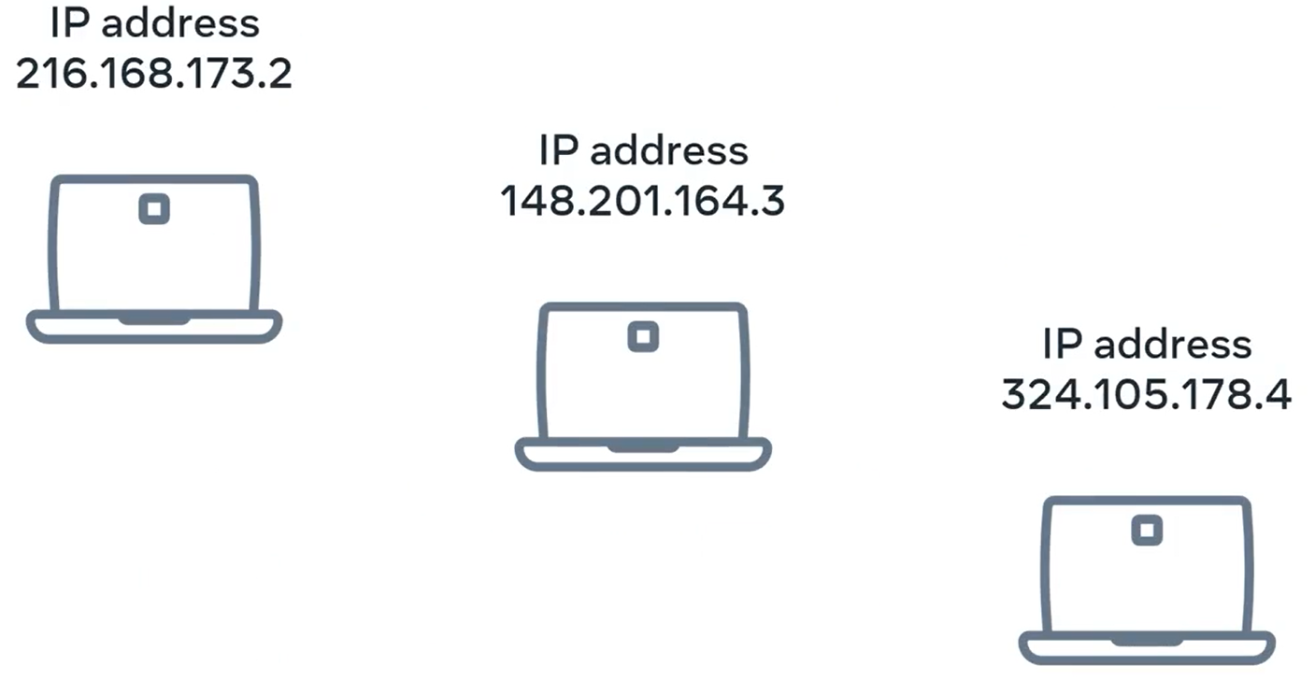
Internet Protocol (IP) Address
Data sent across the internet is quite an important part of our everyday lives and it wouldn't be possible without Internet Protocol addresses or IP addresses.

Slide 5
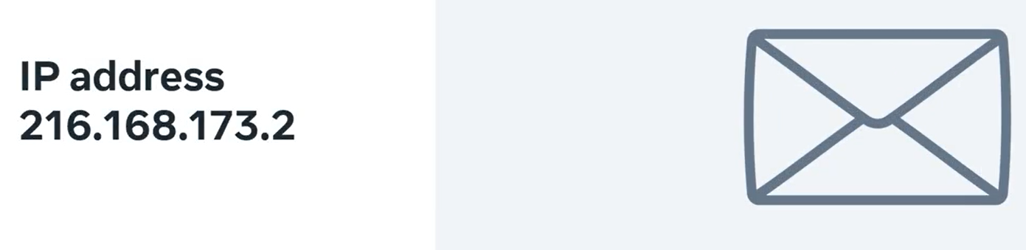
Internet Protocol (IP) Address
A useful way to think of IP addresses is that they function much like addresses in a postal system that make it possible for packets of information to be delivered to you.

Slide 6
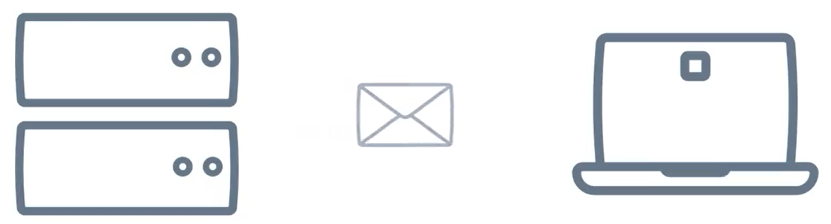
Internet Protocol (IP) Address
And like with the postal system things can go wrong.
But let's first go over how things work. Before we think about how they can go wrong in this video you will learn what IP addresses are and explore how computers send data across the internet.

Slide 7
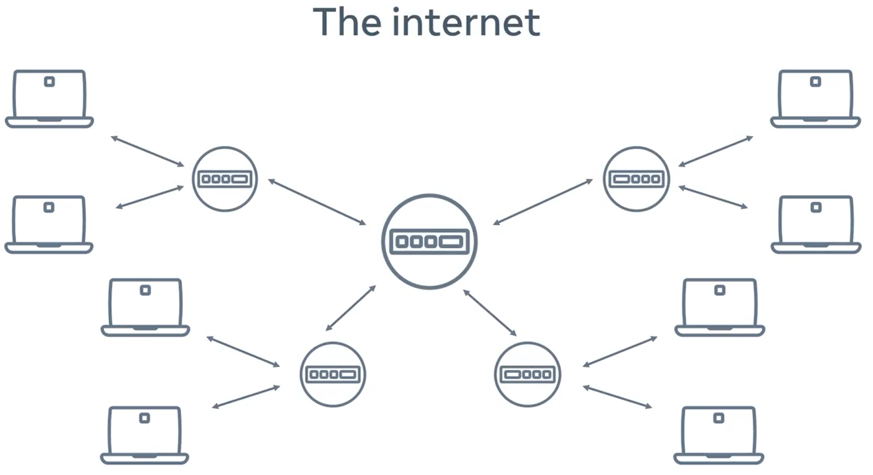
Internet Protocol (IP) Address
You probably learned how computers connect to each other to form networks and how these networks connect to each other to form the internet.

Slide 8
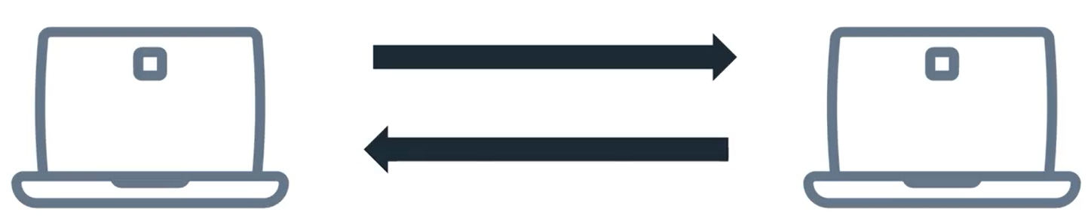
Internet Protocol (IP) Address
When you send data between computers across the internet, a common way of understanding that data is needed by the computers and networks that the data travels across.
What makes that possible is the Internet Protocol.

Slide 9
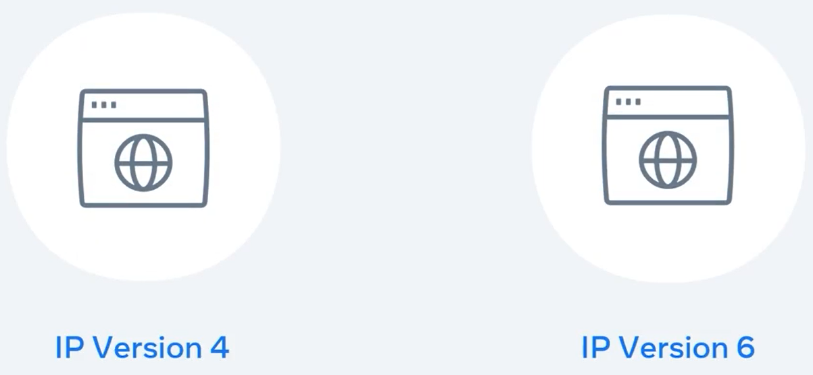
Internet Protocol (IP) Address
Version four and version six are currently the two most widely used standards of internet protocol.

Slide 10
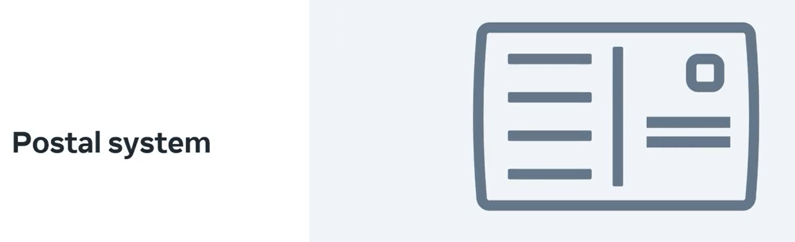
Internet Protocol (IP) Address
Think of the old fashioned postal system again when you send a letter to a friend you need their address otherwise they won't receive your letter.

Slide 11
Internet Protocol (IP) Address
Computers work in a similar way. Every computer on a network is assigned an IP address.

Slide 12
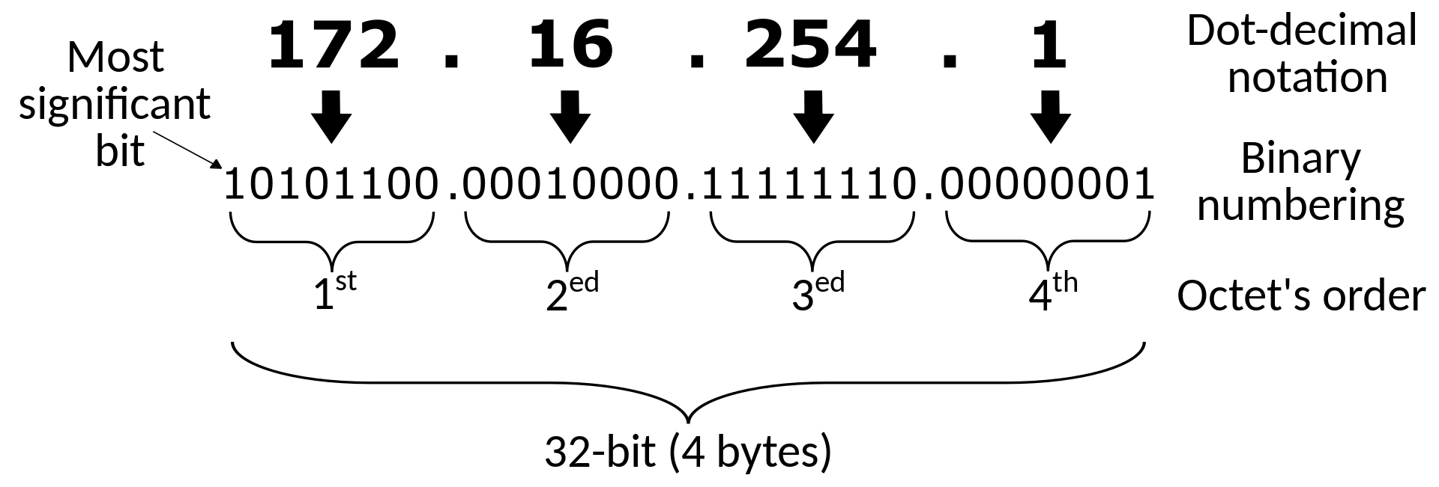
IP Version 4 (IPv4)
In protocol version four, an IP address contains four octet. It's separated by periods or dots. For example, 172.16.254.1

Slide 13
IP Version 6 (IPv6)
In protocol version six, an IP address contains eight groups of hexadecimal digits separated by a colon. For example 2001:0db8:0000:0000:0000:ff00:0042:8329.
The 128 bits of an IPv6 address are represented in 8 groups of 16 bits each. Each group is written as four hexadecimal digits

Slide 14
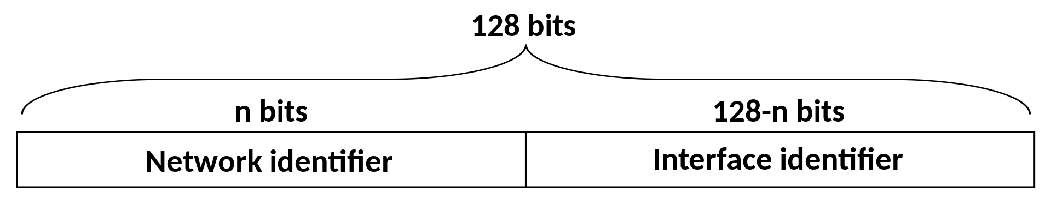
IP Version 6 (IPv6)
After removing all leading zeros in each group: 2001:db8:0:0:0:ff00:42:8329
After omitting consecutive sections of zeros: 2001:db8::ff00:42:8329

Slide 15
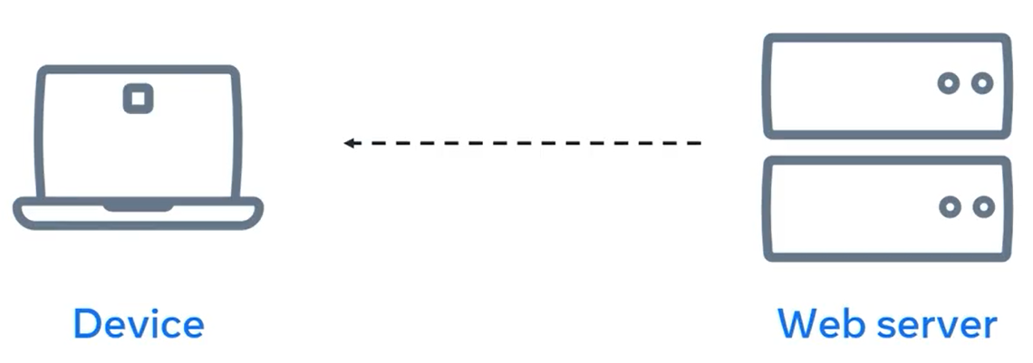
IP Packet
When you send data across a network, you send the data as a series of messages called IP packets. Also known as data grams.

Slide 16
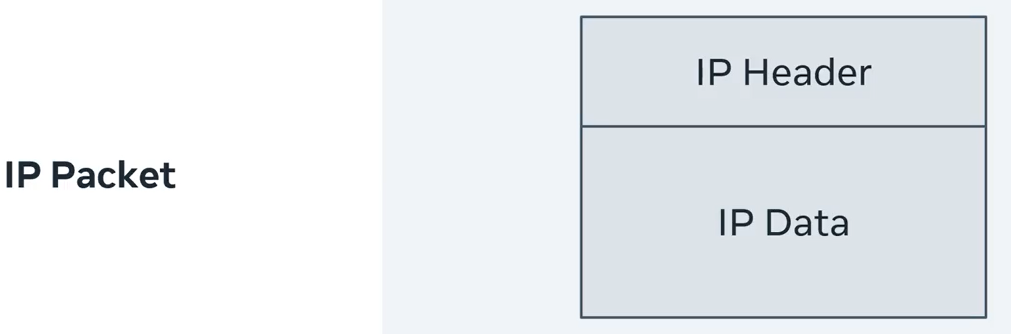
IP Packet
At a high level IP packets contain a header and a payload or the data.

Slide 17
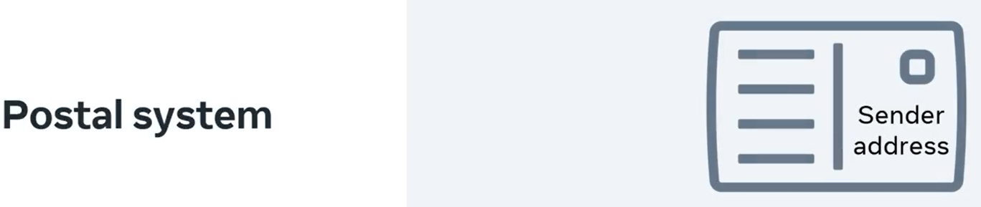
IP Packet
Think of that old fashioned postal system again, when you send a letter. You not only include the recipient's address but also your own address in case a return location is needed.

Slide 18
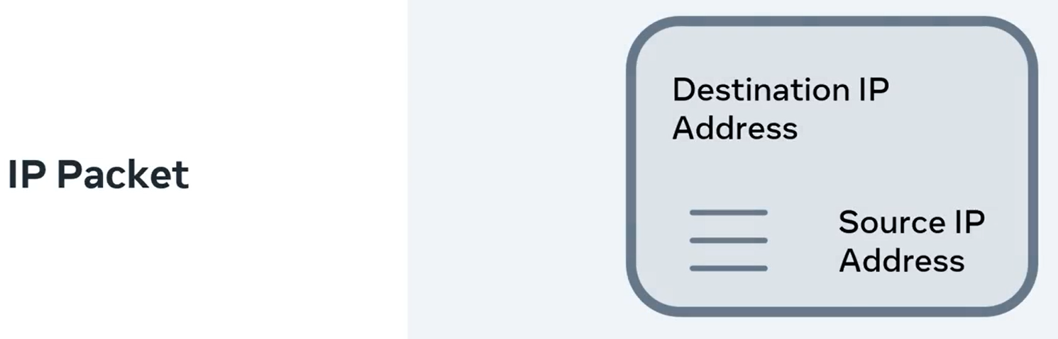
IP Packet
IP packets are the same. They include the destination IP address and source IP address. These addresses are in the header along with some additional information to help deliver the packet.

Slide 19
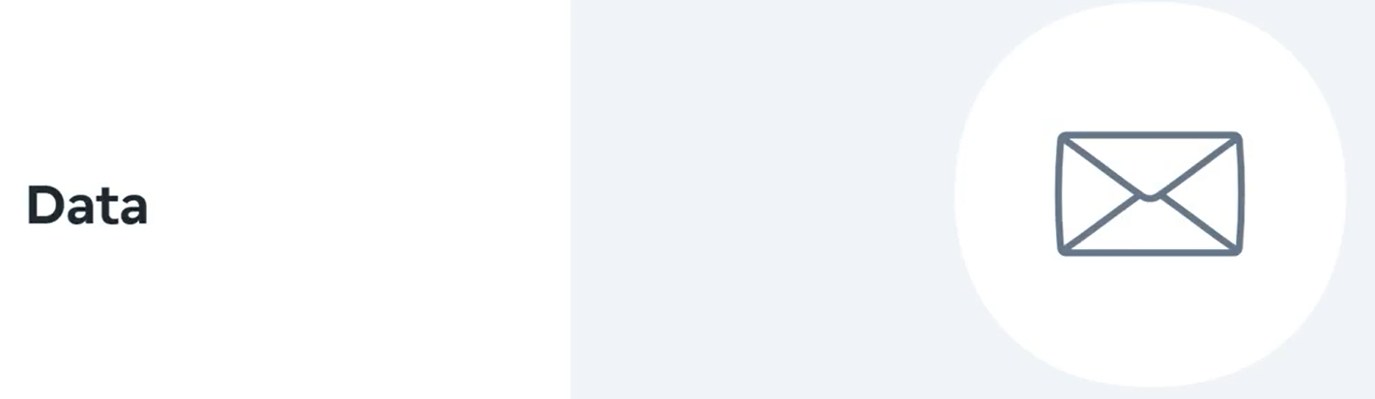
IP Packet
And the payload contains the data of the packet and some of the other protocols which will be covered in a moment.

Slide 20
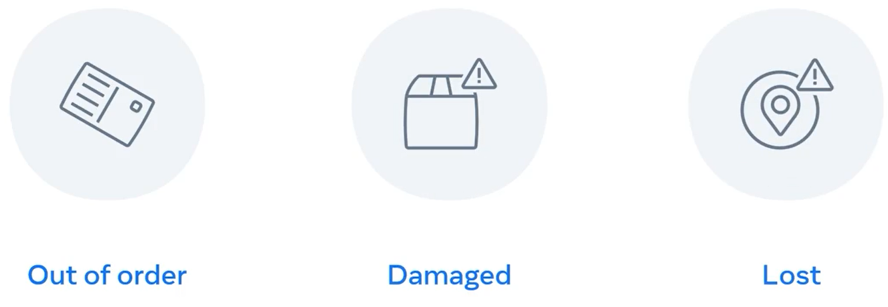
IP Packet
Earlier I mentioned that things can go wrong with the postal system.
When sending multiple letters to a friend it's possible they may arrive out of order.
It's possible that a package will get damaged or if you're really unlucky a letter could get lost.

Slide 21
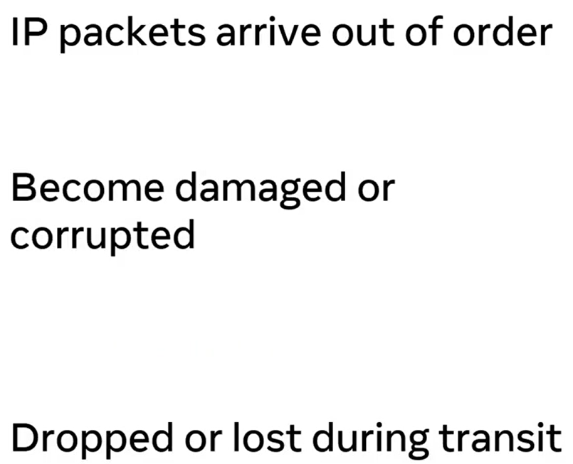
IP Packet
These issues can happen to IP packets too they can arrive out of order, become damaged or corrupted to in transit or be dropped or lost during transit.

Slide 22
TCP / UDP
To solve these problems, the payload part of the packets contains other protocols too. You can think of them as another message inside the payload of the IP packet.
The two most common protocols are the Transmission Control Protocol referred to as TCP and the User Datagram Protocol, also known as UDP.

Slide 23
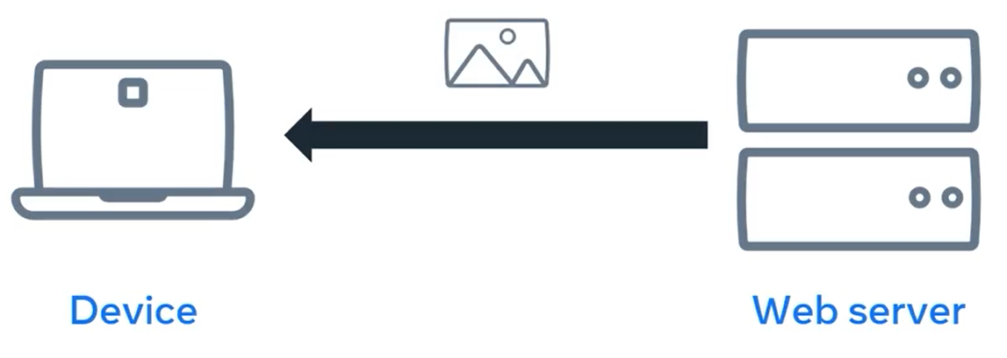
TCP
TCP can solve all three of the previously mentioned issues but at the cost of a small delay when sending the data.
This protocol is used for sending the data that must arrive correctly and in order such as a text or image files.

Slide 24
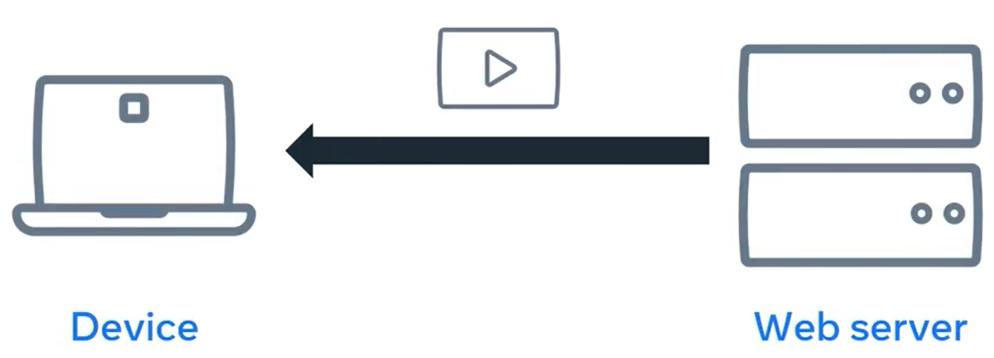
UDP
UDP solves the corrupt packet issue but packets can still arrive out of order or not arrive at all.
This protocol is used for sending data that can tolerate some data loss such as voice calls or live video streaming.

Slide 25
TCP / UDP
Both of these protocols contain payloads that contain further protocols inside of them and there you have it.
The internet uses internet protocols much like an old fashioned postal system.
These protocols can help to make sure that data arrives in order does not become corrupted or lost or dropped during transit.

Slide 26
Summary
After this lecture, you can explain,
How IP addresses work and
how computers send data across the internet.

Slide 27
Additional Resources
Learn more Here is a list of resources that may be helpful as you continue your learning journey.
HTTP Overview (Mozilla)
https://developer.mozilla.org/en-US/docs/Web/HTTP/Overview
Introduction to Networking by Dr.Charles R Severance
https://www.amazon.com/Introduction-Networking-How-Internet-Works/dp/1511654945/
Chrome Developer Tools Overview (Google)
https://developer.chrome.com/docs/devtools/overview/
Firefox Developer Tools User Docs (Mozilla)
https://firefox-source-docs.mozilla.org/devtools-user/index.html
Getting Started with Visual Studio Code (Microsoft)
https://code.visualstudio.com/docs

Slide 28
Thank You

